Slide 1



Schedule an Appointment with the Faculty
Faculty : Advisor: Dr. Robert A. Gilliland

Slide 2

Team Members :
1.Chandra Kanth Chunduru || Y00856662
2. Achyuth Kalyan Maguluri ||Y id: Y00856795
3. Sanjay Noorbasha ||Y id: Y00855265.

Slide 3
Abstract
This project, "Schedule an Appointment with the Faculty," endeavors to revolutionize the process of appointment scheduling within educational institutions
The system, designed with a focus on efficiency and user-friendliness, offers students and faculty members a streamlined platform for managing and scheduling appointments
Our project, "Schedule an Appointment with the Faculty," addresses the inefficiencies in the current manual system of scheduling one-on-one meetings between students and faculty

Slide 4
Problem Domain
In the realm of educational institutions, the current methods of scheduling appointments with faculty members pose significant challenges
The existing manual processes often lead to inefficiencies, miscommunications, and missed opportunities for meaningful interactions between students and faculty
Common problems within this domain include

Slide 5

Time-Consuming Manual Scheduling
The reliance on traditional methods, such as in-person or email-based appointment requests, results in time-consuming processes for both students and faculty

Slide 6

Difficulty in Availability Coordination
Coordinating the availability of students and faculty members manually often leads to scheduling conflicts, making it challenging to find suitable time slots for appointments

Slide 7

Limited Accessibility to Information
Lack of centralized systems means that students may struggle to access up-to-date information regarding faculty members' availability and office hours

Slide 8

Communication Gaps
Miscommunications and missed messages between students and faculty can occur due to the absence of a standardized platform for appointment scheduling

Slide 9

Data Security Concerns
Existing systems may lack robust access control mechanisms, raising concerns about the security and privacy of appointment-related data

Slide 10

Inefficient Resource Utilization
The absence of automated reminders and notifications contributes to missed appointments, leading to inefficient use of faculty members' time and expertise

Slide 11
Integration Challenges
Many institutions lack seamless integration with popular calendar systems, hindering efficient synchronization of appointments and potentially causing conflicts
The problem domain underscores the critical need for a technological solution that addresses these challenges, streamlines the appointment scheduling process, and enhances the overall efficiency and effectiveness of academic interactions within educational institutions
The "Schedule an Appointment with the Faculty" project aims to fill this gap by introducing an innovative system that tackles these issues head-on, providing a modernized and user-friendly solution to optimize the scheduling experience for both students and faculty members

Slide 12
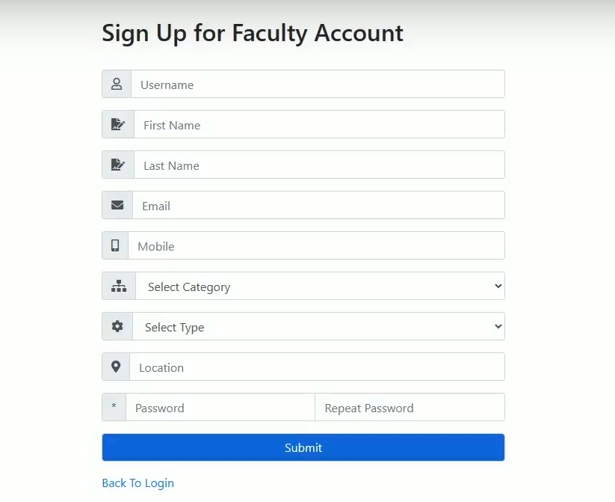
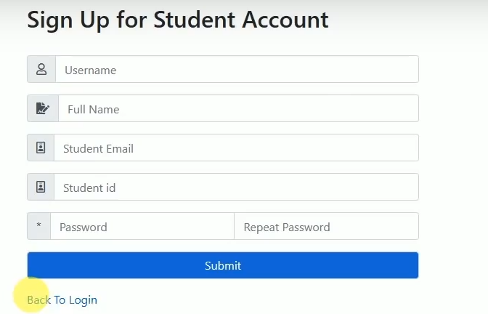
User Interface Design
Importance of an intuitive UI
Brief showcase of the system's user interface
- Signup Interface:

Slide 13
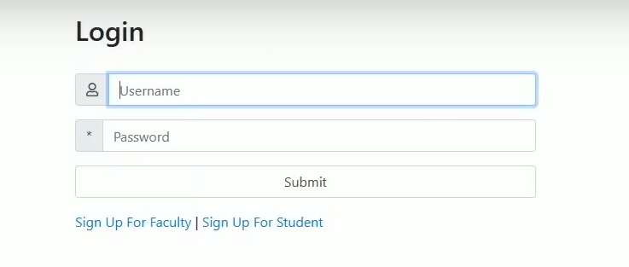
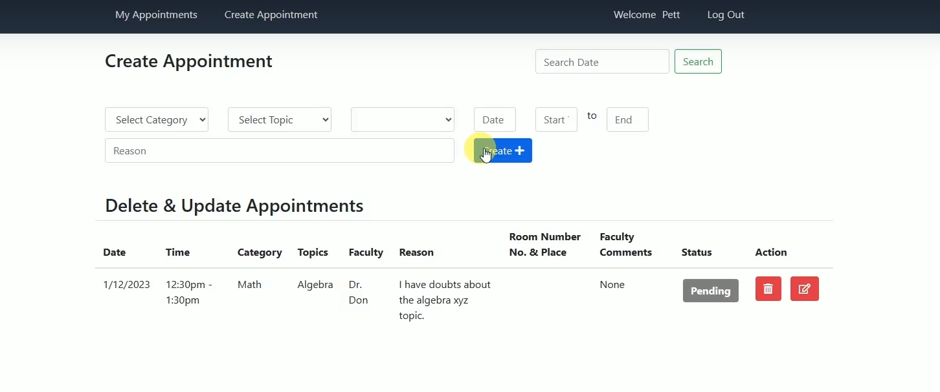
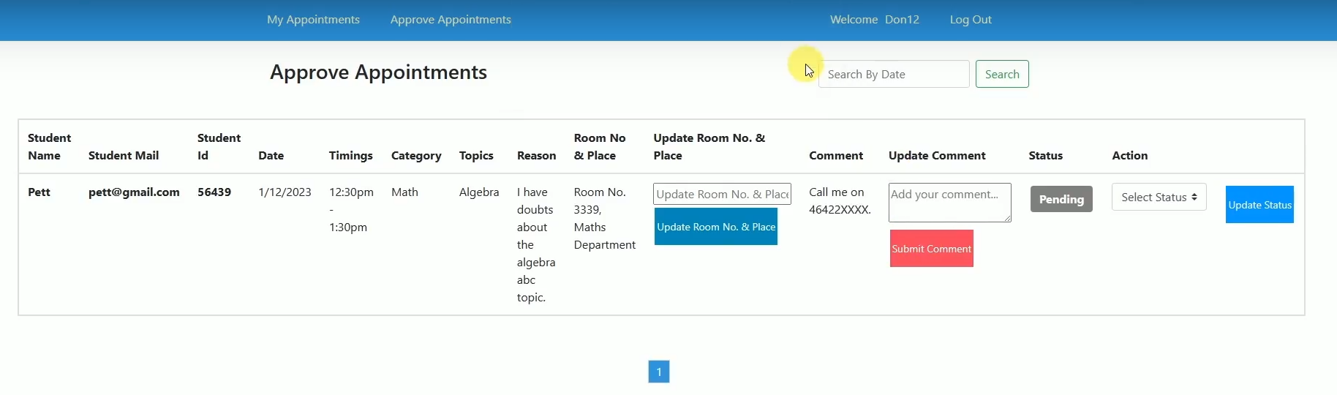
Login Page:
Dashboard of Student
Dashboard for Faculty

Slide 14
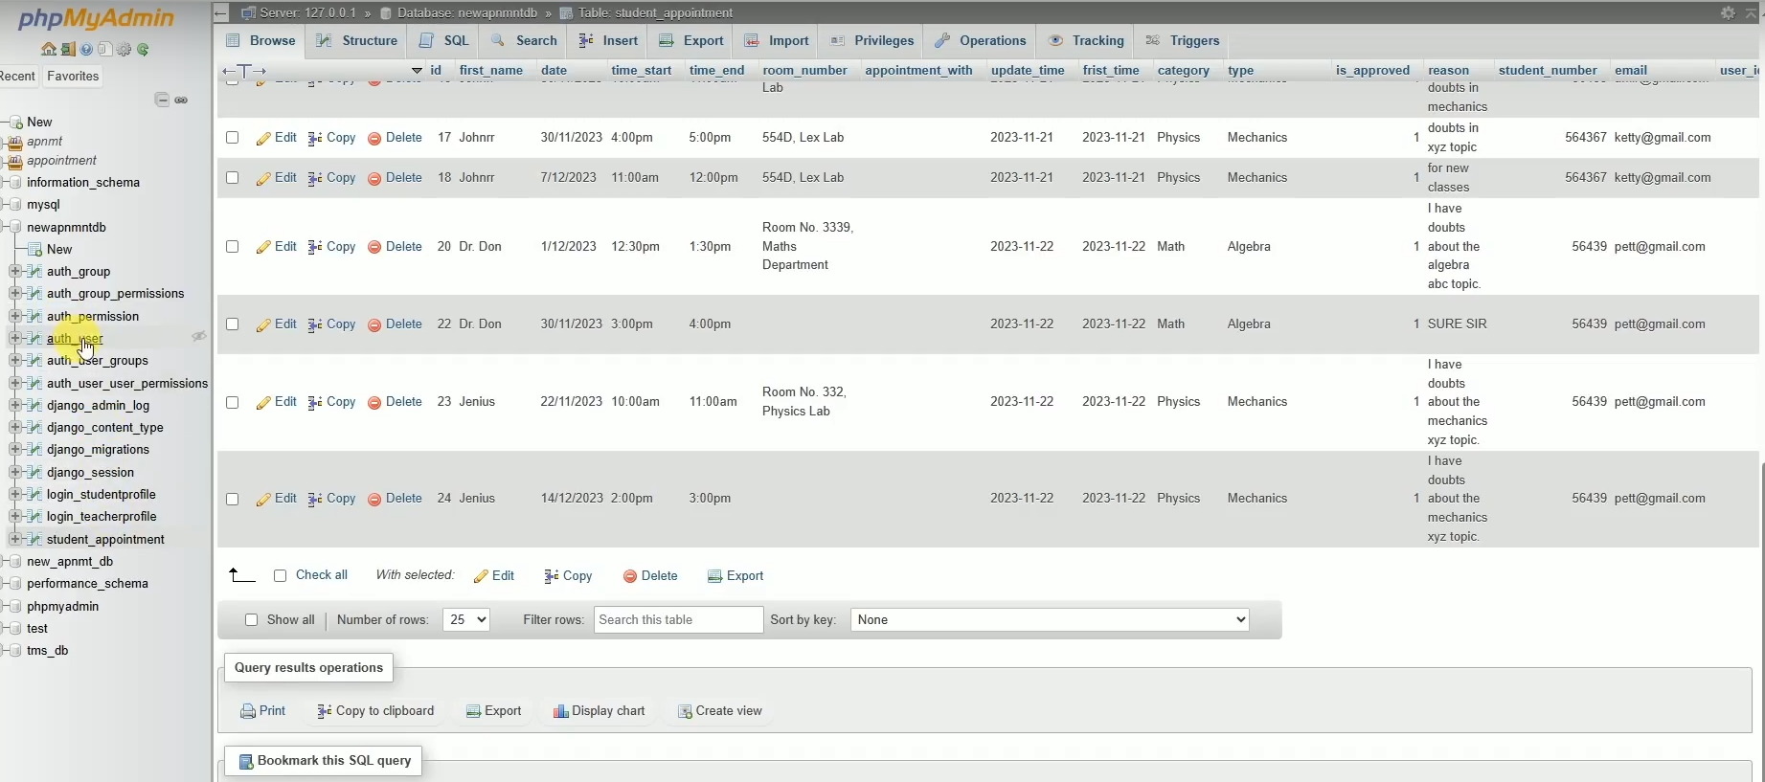
Database entries in MySQL

Slide 15
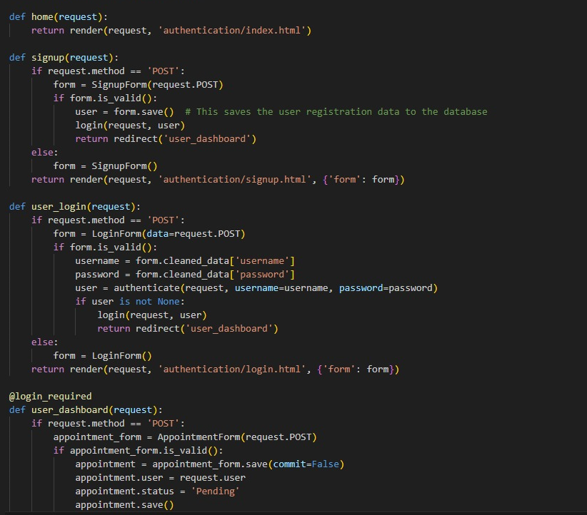
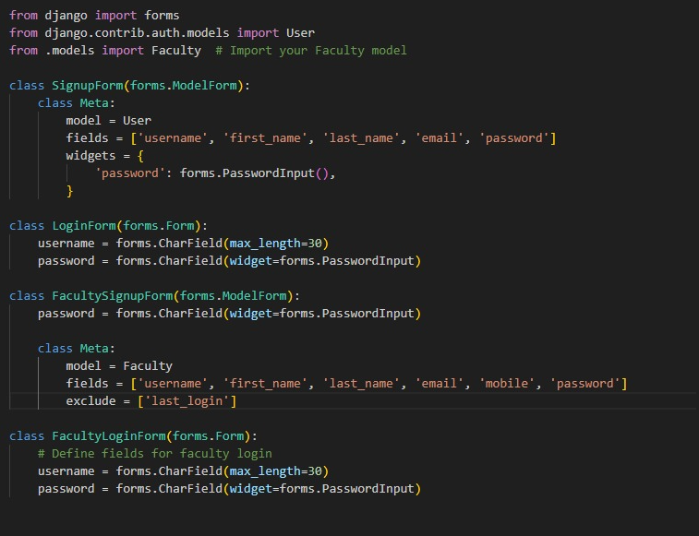
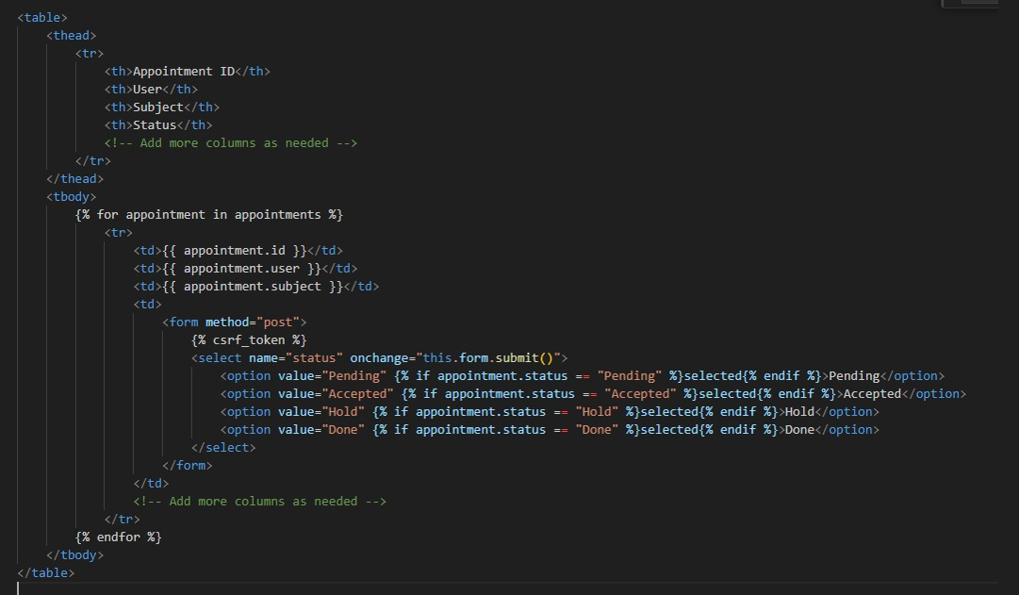
Some Code Snippets:

Slide 16

Technical Approach
The technical approach for the "Schedule an Appointment with the Faculty" project involves a systematic implementation of technologies and methodologies to achieve the project objectives
The following outlines the key components of the technical approach

Slide 17
1. Architecture and Technologies
Frontend Development: Utilize modern web development technologies such as HTML, CSS, Javascript and Bootstrap to create a responsive and user-friendly interface for students and faculty
Backend Development: Implement a robust backend using Python to handle the logic, manage databases, and communicate with the frontend
Database: Employ MySQL DB for data storage, providing a flexible and scalable solution for managing appointment schedules
Authentication: Implement secure user authentication to ensure authorized access to the system

Slide 18

2. User Authentication and Authorization
Implement a user registration and login system to authenticate students, faculty, and administrators
Utilize role-based access control to define and manage user roles, ensuring that only authorized individuals can perform specific actions

Slide 19

3. Appointment Scheduling Algorithm
Design and implement a smart scheduling algorithm that considers the availability of both students and faculty members
Incorporate a user-friendly calendar interface to visualize available time slots and facilitate easy selection for appointment scheduling

Slide 20

4. User Interface Design
Develop an intuitive and aesthetically pleasing UI that enhances the user experience
Prioritize responsive design principles to ensure accessibility across various devices and screen sizes

Slide 21

5. Security Measures
Implement secure coding practices to protect against common web application vulnerabilities
Conduct regular security audits and penetration testing to identify and address potential vulnerabilities

Slide 22

6. Scalability and Performance
Design the system with scalability in mind to accommodate growth in user base and data volume
Optimize database queries and application logic for performance, ensuring a seamless experience even during peak usage periods

Slide 23

7. Documentation and Knowledge Transfer
Develop comprehensive documentation for system architecture and deployment procedures
Conduct knowledge transfer sessions for administrators, ensuring they are well-equipped to manage and maintain the system

Slide 24

8. Testing and Quality Assurance
Implement a rigorous testing strategy, including unit testing, integration testing, and end-to-end testing
Conduct user acceptance testing to gather feedback from actual users and refine the system accordingly

Slide 25
9. Continuous Integration/Continuous Deployment
Set up CI/CD pipelines to automate the testing and deployment processes, ensuring a smooth and reliable release cycle
Implement version control using tools like Git to track changes and facilitate collaboration among development teams

Slide 26

Standards and Constraints
Standards: All programming was done in Visual Studio Code Version 1.83.1 from the Microsoft
Constraints: All software was required to run on an Intel i7 quad-core processor with latency less than 10 milliseconds

Slide 27
Acknowledgements
We also look forward to perform a technology transfer to interested Business stakeholders and Industries
Emphasize how the system addresses specific pain points or challenges in appointment scheduling within educational institutions

Slide 28
1. Identify Target Audience
Understand the different stakeholders within the business or industry who would be interested in or affected by the scheduling system
Tailor messages to address the unique needs and concerns of each stakeholder group

Slide 29

2. Develop Marketing Collateral
Create visually appealing and informative materials such as brochures, infographics, and presentations

Slide 30

3. Engage in Networking Opportunities
Attend relevant industry events, conferences, or trade shows to present the scheduling system
Engage with potential clients, partners, or collaborators

Slide 31
4. Measure and Analyze Success
Implement key performance indicators to measure the success of the introduction
Analyze user adoption rates, feedback, and any other relevant metrics
Continuously gather insights and feedback to iterate on the system and its introduction strategy

Slide 32
5.Future Enhancements
Potential future developments and features
Scalability considerations
Implement secure user authentication using JSON Web Tokens (JWT) to ensure authorized access to the system.
Develop a RESTful API for seamless communication between the frontend and backend components.

Slide 33

Conclusion:
The "Schedule an Appointment with the Faculty" project aims to improve the efficiency and convenience of appointment scheduling in educational institutions. By implementing a user-friendly system with automated notifications and calendar integration, the project seeks to enhance the overall experience for both students and faculty members

